Slide 1

CS 4662 Heart Failure Prediction Presentation
Team Members: Harish Lakshman, Steven Gonzales, Shalini Nistala
Date April 26th 2025

Slide 2
INTRODUCTION
Purpose:
To create and compare different machine learning algorithms for generating predictive models aimed at predicting Heart Failure based on patient data.
Goals:
Utilize the dataset containing patient characteristics diagnosed with CHF (Congestive Heart Failure) to train and test various models and algorithms. The ultimate goal is to predict DEATH_EVENT=1.

Slide 3
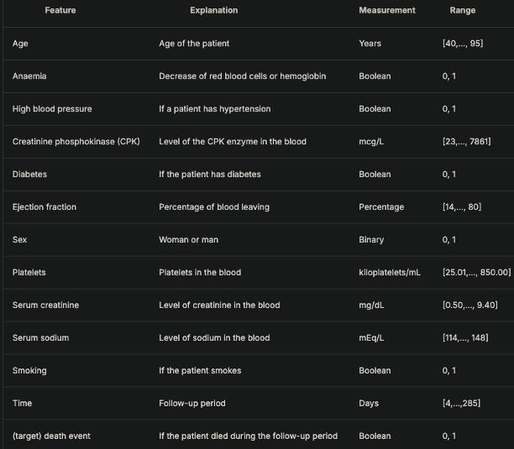
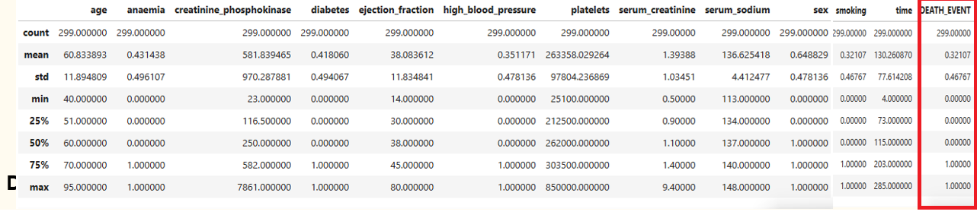
Data Overview:
The dataset captures patient information to analyze factors leading to heart failure
All features in the dataset are numerical and can be broadly categorized into two groups: Binary features and Continuous features.
Notes:
Data Overview:
“HeartFailure dataset includes features depicted in Figure 1."
Data Processing Steps:
"Datasets were loaded into data frames from sklearn."
"Features and labels were analyzed through histograms and box plots to understand distributions and outliers (Figures 1 and 2)."
"Statistical summaries provided insights into feature behaviors (Figure 2)."
"Categorical data within the features was identified and transformed for model training."

Slide 4
Feature Classification:
Binary Features: Smoking, Sex, High Blood Pressure, Diabetes, Anaemia
Continuous Features: Age, Creatinine Phosphokinase, Ejection Fraction, Platelets, Serum Creatinine, Serum Sodium
Feature Description:
Serum Creatinine: Kidney Damage Marker
Creatinine Phosphokinase: Muscle/heart enzyme levels
Ejection Fraction: Heart pumping efficiency
Platelets: Blood clotting cell fragments

Slide 5
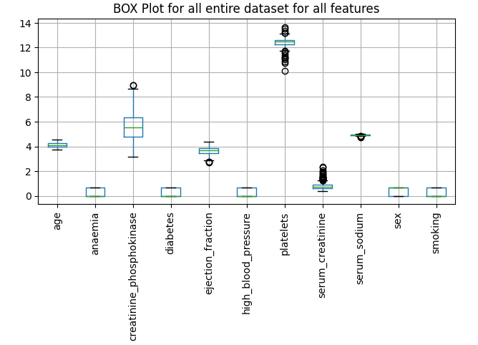
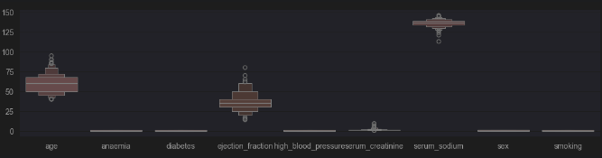
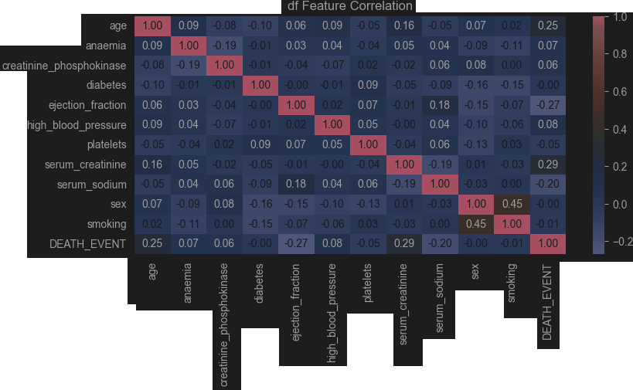
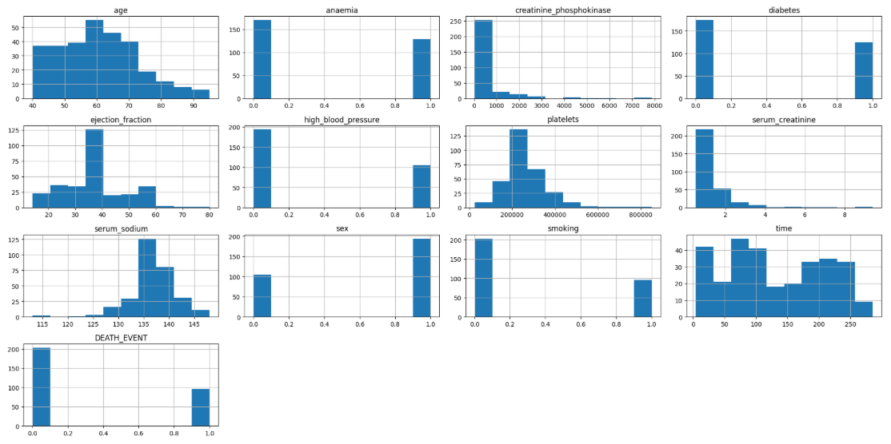
Data Analysis & Feature Extraction

Slide 6
Data Exploration
– Metrics function/Class
– Preprocessing
– Checking for imbalance / imbalance handling via SMOTE
– Decision Tree: Feature Importance Analysis
– Normalization: Choosing our scalers
– Traditional Methods — eg: logistic regression, naïve bayes, etc.
– Trying PCA (anyways)
Notes:
so, before we get to the meat and potatoes (of the new algorithms)
… we have DATA EXPLORATION:
-----------
– We defined Metrics function to: train, test, & assess our models across different metrics.
– F1 is very important (for medical applications), —but also: accuracy_score, roc_AUC … and all of our predictions / cv_predictions so we can look at them later
– so we have them all in one place
– … it actually runs everything but the keras models were tricky for cross validation
– We check for imbalance, & end up using: SMOTE (S.ynthetic M.inority O.versampling T.echnique)
– Then, we run traditional algorithm, see if best features change for: Decision Tree & Random Forest — as well as others algorithm
– we also ran PCA for thoroughness / breadth —even though our dataset is so small.
… few datapoints, highly correlated

Slide 7
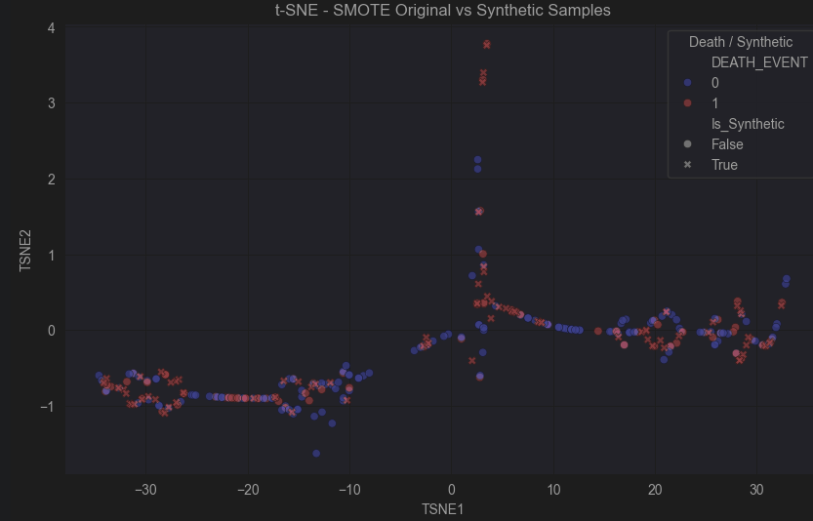

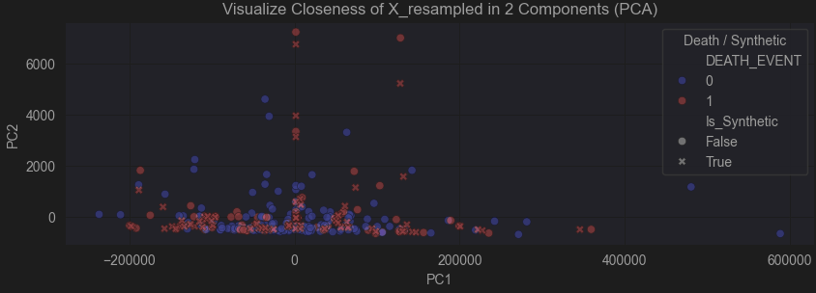
Preprocessing
Dropping the time column
Checking for imbalance
imbalance handling via SMOTE
Notes:
We dropped the time column: it was like cheating (most algorithms performed better, but we can’t use it as it is future information) —really obscure and hard to verify this information but it made sense.
# (future) event time (generated along w/ DEATH_EVENT) (or study length, study WILL end abrubtly from either LIVING & ending reporting, or DYING from 'Myocardial Infarction Event’)
So it could tell us a lot or a little, (patient could have lived forever or died after study concludes w/ ZERO for DEATH_EVENT)
used SMOTE due to ”the nature of these datasets” (medical)
– imbalanced
– few data points
– highly correlated
Here’s some SCATTERPLOTS: We have to see if noise was introduced.
________________________________________________________________
PCA (2 components scatterplot)
Blue circles = majority class original Red circles = minority class original Red X’s = synthetic samples added by SMOTE ... No outliers => no noise found.
X's (synthetic)
are all near red circles (original's from minority class)
TNSE: we see the same (but with a better view) ——synthetic samples all very close to original samples

Slide 8

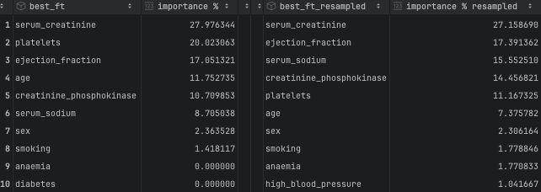


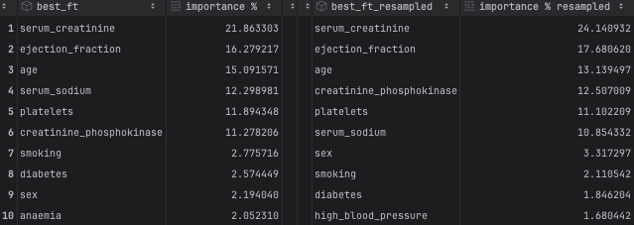

Preprocessing: Detecting SMOTE noise (2)
We compare Random Forest & Decision Tree best features for changes between X_train & X_train_resampled
Notes:
Decision Tree: Invariant to scaling (luckily, so we run before choosing our scaler)
– most notable importance fluctuations: &nbsp; ejection_fraction ± 4.5%, &nbsp; age ± 3%
Random Forest
– no huge fluctuations (little noise)
– but confirms most of decision tree: (ie: 1: serum_creatinine, 2: ejection_fraction 3?: creatinine_phosphokinase/platelets/age, serum_sodium, ...)
Makes sense because ejection_fraction is how well your heart pumps,
& serum_creatinine (kidney damage)

Slide 9
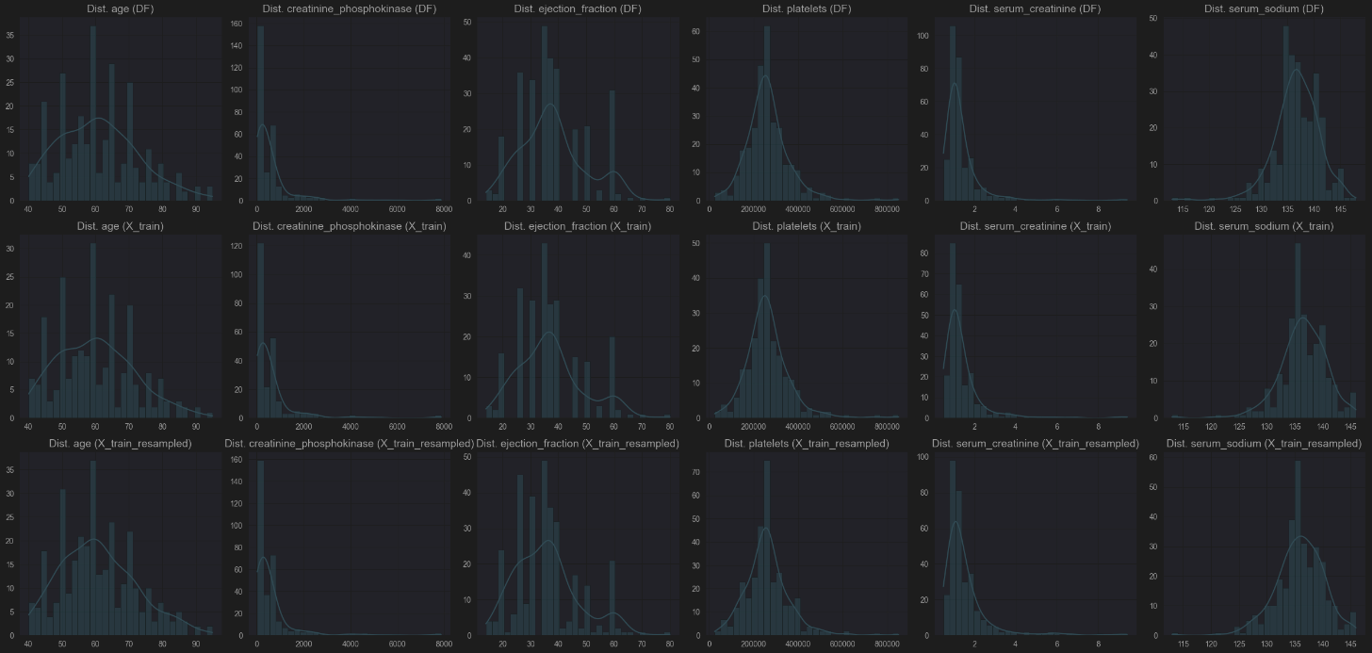
Preprocessing: Normalization (choosing a scaler)
Notes:
Histplots:
These are the counts of the popularity of each non-binary feature-values in the dataset. (ie: age: 60 is the most common in the dataset (see: the tallest bar/pile)) If Gaussian, KDE curve resembles a bell shape centered around the mean... Kernel Density Estimate/KDE curve is a smoothed approximation of feature-value distribution –like a continuous version of histogram) Observations: Gaussian w/ few peaks; using SMOTE/resampled leads to following Gaussian curve more closely => use StandardScaler (Z-score normalization)
MinMax supposed to help with ANN, shows in good_models for: mlp_resampled_minmax
So we try that too

Slide 10
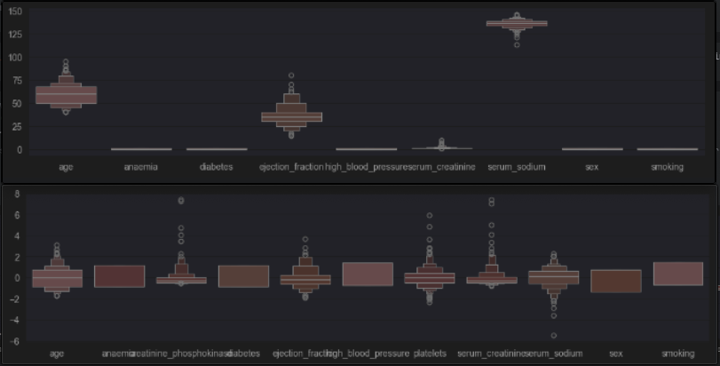
Preprocessing: Effects of Normalization
Notes:
Quick: boxen plots to show affects of normalization
(shown without ‘platelets’ with up to 600000) —bad for visualization towers over the rest (could’ve hid binary too)
Notice ranges shrink [0, 600000] => [-8, 8]
=> NEXT SLIDE

Slide 11
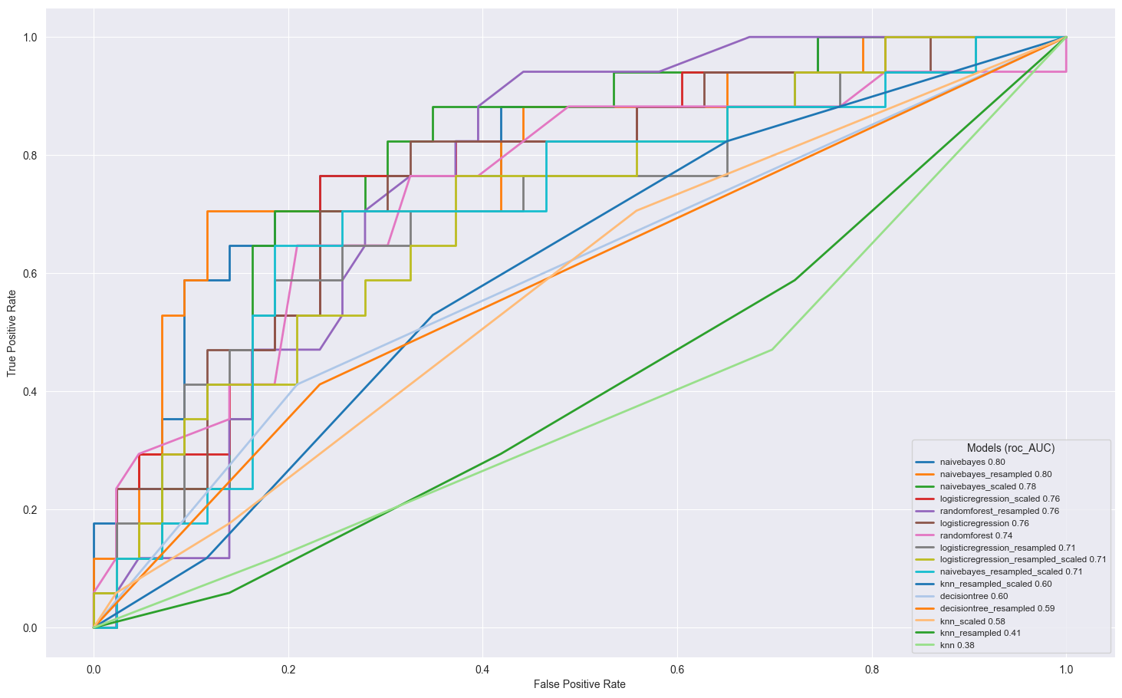
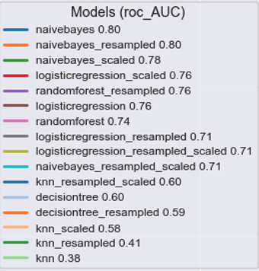
Traditional Methods
Notes:
Traditional methods right so for this classification problem we have DEATH_EVENT=1 or 0.
–So, we of course forewent linear regression for logistic regression, tried decision tree, etc.
We tried across different metrics. (focus on F1)
We tried across different stages. (train, train_scale, train_resample train_resample_scaled)
, and what we found
Best F1: randomforest_resampled (81.7%) Best roc_AUC: naivebayes_resampled (0.8) Best cross_validation: randomforest_resampled (81.6%)
Which makes sense since it’s an ensemble of decision trees
… we also used grid_search to find the best n_estimators=69
(1,
('randomforest_resampled',
acc: 0.7166666666666667
cv_mean: 0.815625
f1: 0.8169773531422138
roc_AUC: 0.7585499316005472)),
(2,
('logisticregression_resampled’, ––probably the most consistent across all metrics (LOGISTIC REGRESSION’S)
acc: 0.7333333333333333
cv_mean: 0.7625
f1: 0.7609816018497233
roc_AUC: 0.7113543091655267)),
…
(4,
('naivebayes_resampled',
acc: 0.8
cv_mean: 0.665625
f1: 0.6225056420940737
roc_AUC: 0.7961696306429549)),
Resampling w/ SMOTE was a good idea (for TRADITIONAL at least)

Slide 12
Machine Learning Algorithms used
Convolutional Neural Network
Implement Conv1D to extract meaningful local patterns from features of Heart Failure Dataset
Used MaxPooling to reduce dimensionality (pool_size=2)
GlobalAveragePooling flattens into a vector
Added Dense layers for final prediction
Artificial Neural Network (SkLearn method & Keras/TensorFlow methods)
Implement ANN by instantiating as an "object" of MLPClassifier "class"
Attempted cross-validation, Grid search with single hidden layer & Grid search with 2 layers.
Implemented a Sequential model from Keras module with 4 Dense layers.
Support Vector Machines
Implement Support Vector classifier for classification task on Heart Failure Dataset.

Slide 13
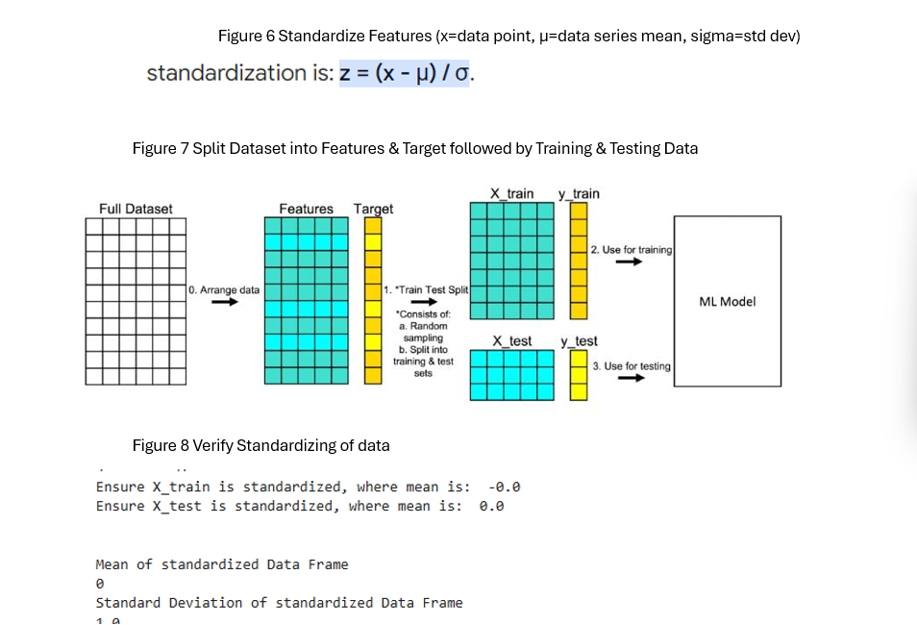
Extract Features & Labels. Standardize Features. Encode Labels & Split data

Slide 14
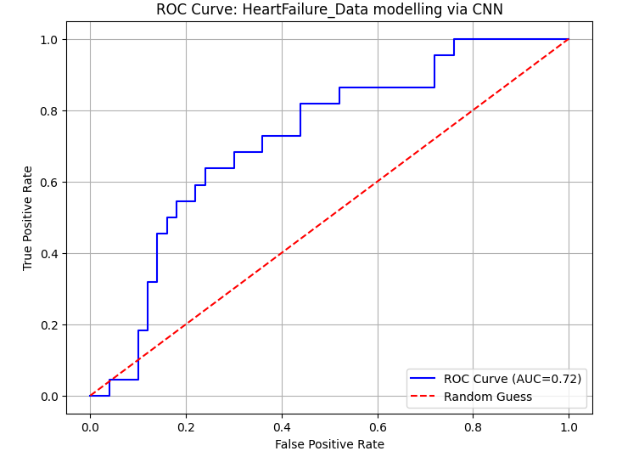
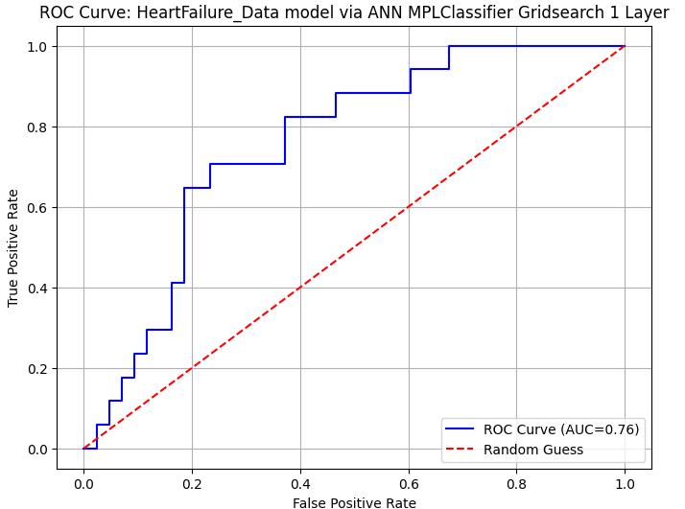
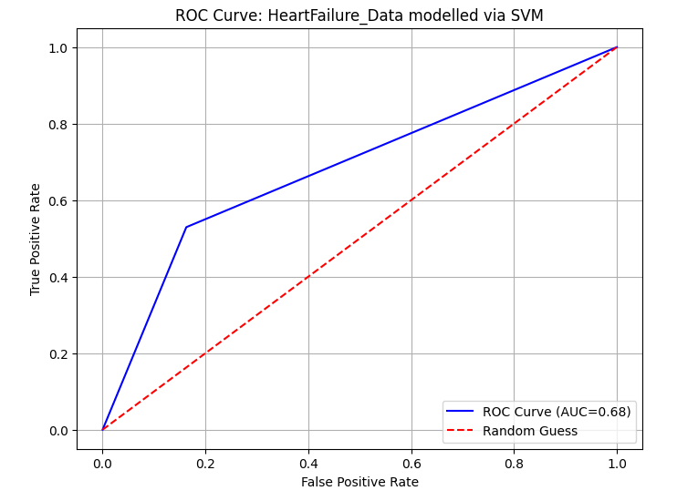
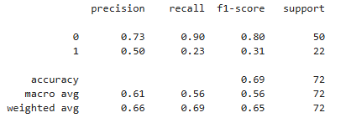
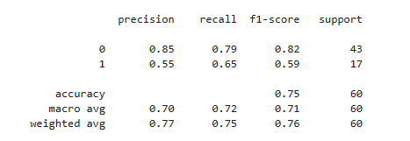
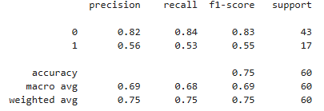
Compare ROC, Accuracy & AUC

Slide 15
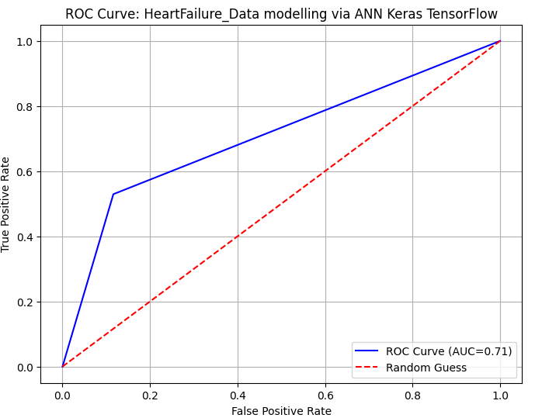
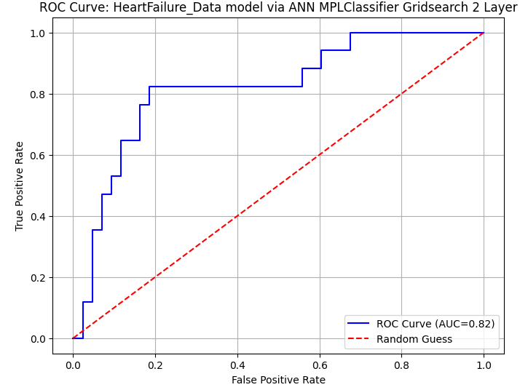
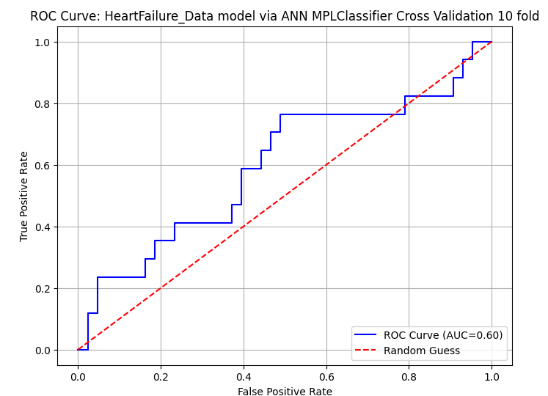
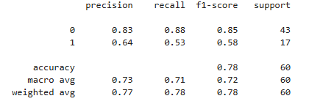
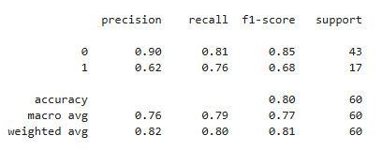
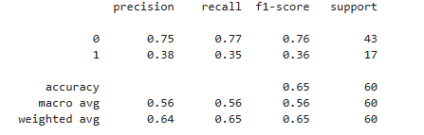
Compare ROC, Accuracy & AUC

Slide 16
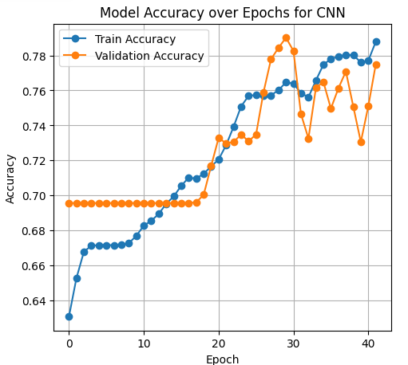
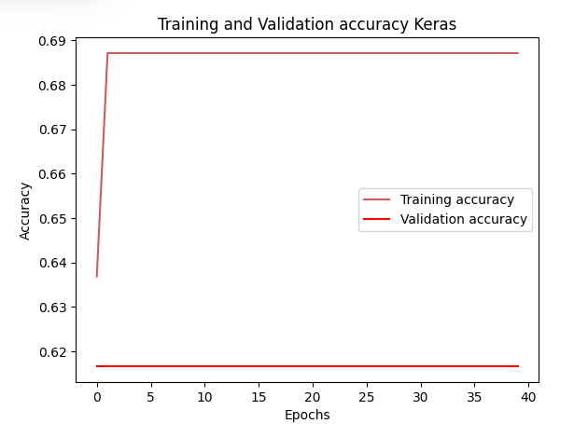
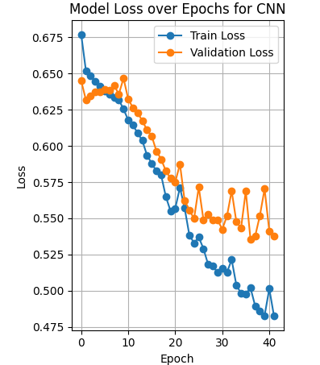
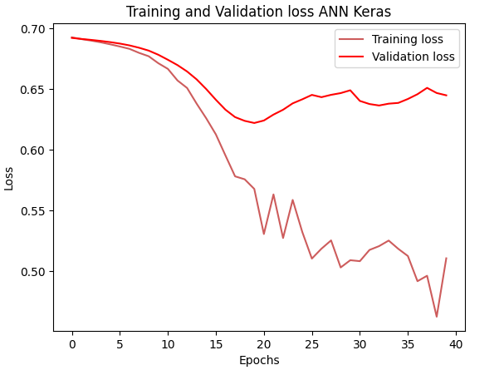
Compare Accuracy over Epochs for 1D CNN & ANN Keras

Slide 17
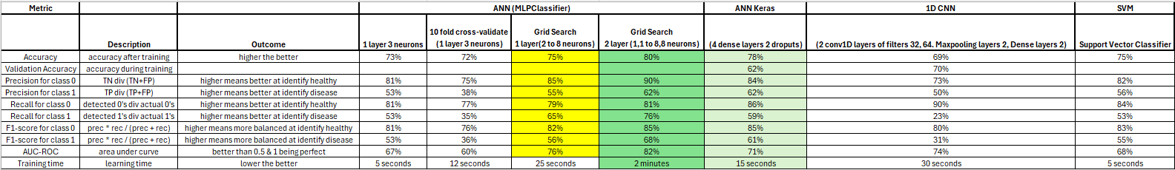
Metrics for all my executed Models

Slide 18
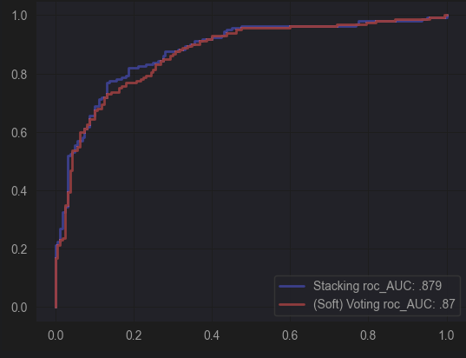
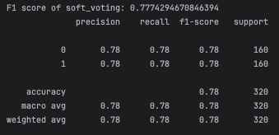
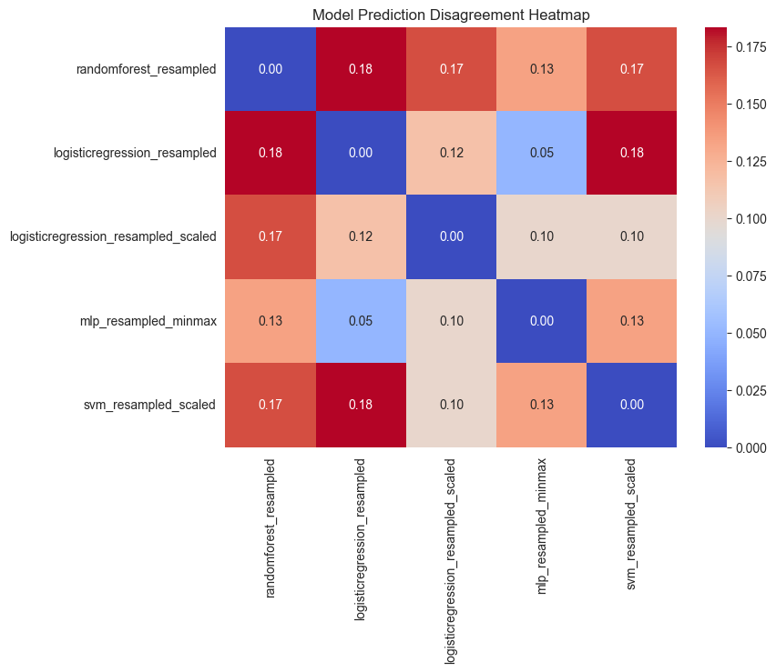
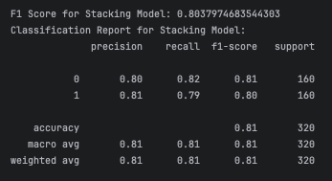
Ensemble Approach: Stacking & Voting (Soft)
Greedy approach: find good models, pick n that increase diversity
Notes:
Looking for 3 good models:
good_models = ['randomforest_resampled’, logisticregression_resampled’, 'logisticregression_resampled_scaled’, 'mlp_resampled_minmax’, 'svm_resampled_scaled’]
Thresholds for good model: [0.7, 0.7] (for ROC & F1)
1. Find very best
2. Look @ Disagreement matrix (for diversity)
– Selected models:
– randomforest_resampled
– logisticregression_resampled
– svm_resampled_scaled
And we of course used soft voting as it is preferred for medical applications
…so the best model: stacking model —but soft voting not far behind
Ensemble is very effective.
RESULTS:
Soft Voting ROC AUC: 0.8704296874999999
Stacking ROC AUC: 0.8796875
F1 score of soft_voting: 0.7774294670846394
precision recall f1-score support
0 0.78 0.78 0.78 160
1 0.78 0.78 0.78 160
accuracy 0.78 320
macro avg 0.78 0.78 0.78 320
weighted avg 0.78 0.78 0.78 320
Stacking Model:
precision recall f1-score support
0 0.80 0.82 0.81 160
1 0.81 0.79 0.80 160
accuracy 0.81 320
macro avg 0.81 0.81 0.81 320
weighted avg 0.81 0.81 0.81 320
The best among all metrics, and especially for detecting positive cases (recall & precision) for DEATH_EVENT.
Thank you.
[PRESENTATION ENDED]

Slide 19
Code
Our code

